Slide 1
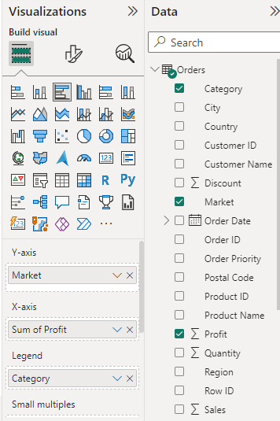
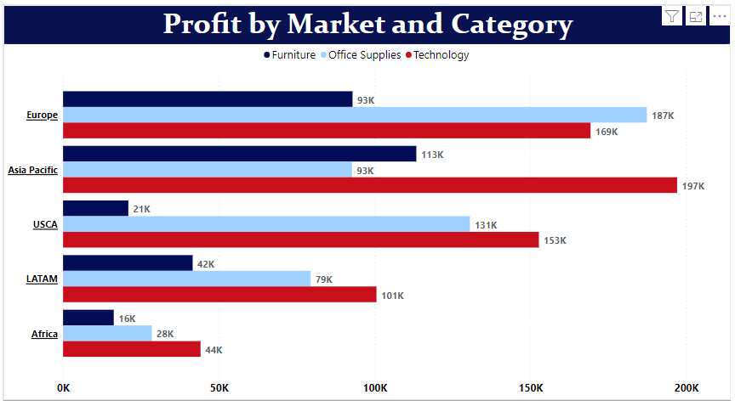
CLUSTERED BAR CHART
A clustered bar chart is a horizontal chart, which could present multiple bars in the form of a cluster.
The horizontal bars basically group together, as they are under the same, y values.
For this kind of chart we need two types of data:
Text Data – 2 , with less distribution. For E.g., Market and Category ,
Numerical Data-1, e.g. Profit Sales

Slide 2
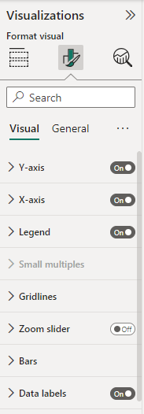
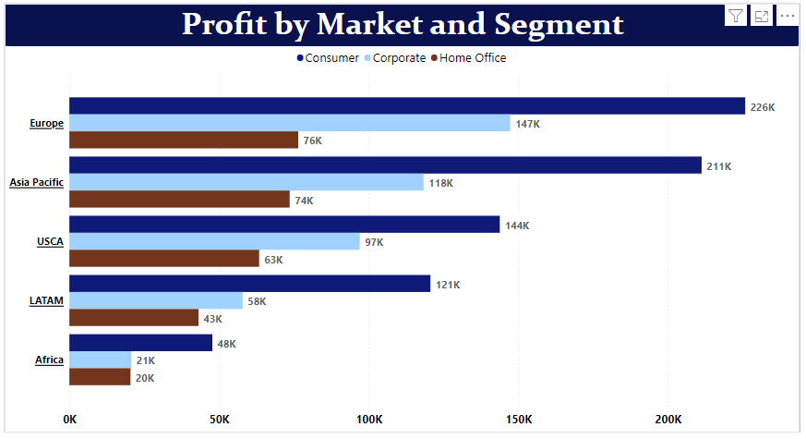
After the successful, creation of a clustered bar chart in Power BI. We have multiple options to format it. For example, adding the title to the chart, changing the color, and position of the chart, and adding tooltips, bar colors, and data labels to the chart.

